Slide 1

Statistical Process Control (SPC)
CONTROL LSS27
Version: June 26
Notes:
Welcome to Statistical Process Control, the second module in the Control phase of Lean Six Sigma.
Today we will focus on how to use process data to tell the difference between normal day-to-day variation and a meaningful change that deserves investigation. Throughout the session, I will connect the concepts to workforce services so the examples feel practical and relevant to Equus projects.
By the end, you should be able to look at a control chart and explain what the process is telling you, without reacting to every individual result.
Transition: Let’s begin with a few quick expectations for our virtual session.

Slide 2


Virtual Classroom
Module
90 mins together.
Please mute your microphone if you are not speaking.
Q&A during the session in chat.
Define
Measure
Analyze
Improve
Control
Notes:
Before we get started, a few quick housekeeping items. We have 90 minutes together. Please mute your microphone when you are not speaking so everyone can hear clearly.
Questions are welcome throughout the session. You can add them to the chat as they come up, and I will pause at key points to address them. There will also be opportunities to work through examples together.
This module sits in the Control phase of the Lean Six Sigma method. The focus is not just on making an improvement, but on making sure the improvement lasts.
Transition: Let’s place today’s session within the overall Control curriculum.

Slide 3
Control Modules
Statistical Process Control is 1 of 2 modules you will study in Control:
LSS26 Intro to Control
Define
Measure
Analyze
Improve
Control
LSS27 Statistical Process Control
Notes:
The Control phase includes two modules. The first introduces the purpose and activities of Control. This module, LSS27, builds on that foundation by focusing on Statistical Process Control.
SPC gives us a structured way to monitor performance after an improvement has been implemented. For an Equus project, that might mean watching participant enrollment time, referral-to-service time, employer response time, or the number of incomplete case records.
The important point is that Control is active. We do not simply close a project and hope the results continue. We put measures in place so the Process Owner can see whether the new process remains stable.
Transition: Here is what you should be able to do by the end of the session.

Slide 4

Module Learning Outcomes
Introduction to Control– LSS 26
By the end of this module, you will: Understand how to select measurements for monitoring an improved process. Know how to use statistical process control (SPC) charts to monitor process performance and identify warning signs of process failure.
Notes:
By the end of this module, you should be able to do two things.
First, select meaningful measures for monitoring an improved process. The measure should tell us whether the outcome that mattered to the project is being sustained.
Second, use an SPC chart to monitor performance and recognize warning signs that the process may have changed.
For example, if an Equus team improves the time from participant referral to first appointment, the team needs a clear measure, a consistent method of collecting it, and a way to recognize when performance is no longer following the expected pattern.
We are not trying to turn everyone into a statistician. The goal is to make confident, evidence-based operational decisions.
Transition: Let’s start by defining Statistical Process Control.

Slide 5
Defining Statistical Process Control
01
CONTROL LSS27
Notes:
Now we are moving into our first section: defining Statistical Process Control, or SPC.
The term can sound technical, but the idea is straightforward. SPC is a way of using data over time to understand how a process normally behaves and to highlight when something meaningful has changed.
In workforce services, that could mean monitoring how long eligibility verification takes, how quickly a participant moves from referral to enrollment, or how consistently follow-up contacts are completed.
As we work through this section, focus on the decisions the chart helps us make, not just the calculations behind it.
Transition: First, let’s briefly recap how SPC fits into the Control phase.

Slide 6
Control Recap
The Control phase ensures improvements are sustained and become part of day-to-day operations.
There are three parts to the Control phase:
Input Data and Information
Control Activities
Output Documentation
What do we need?
Improved process
Pilot results
Critical metrics
Process documentation
What actions do we take?
Standardize improvements
Create a control plan
Monitor performance
Transition to business as usual
What outputs do we produce?
Control plan
Defined performance metrics
Updated process documentation
Training materials
Project closure report
Notes:
The purpose of the Control phase is to sustain the improvement and make it part of normal day-to-day operations. A project is not truly successful if performance improves for a few weeks and then returns to the old pattern.
There are three connected parts. First are the inputs: the improved process, pilot results, critical measures, and current process documentation. Second are the Control activities: standardizing the change, creating a control plan, monitoring performance, and transitioning the work into business as usual. Third are the outputs: updated measures, documentation, training materials, the control plan, and the closure report.
For an Equus example, imagine a project reduced the average time from referral to first service from ten days to six. The Control phase establishes who owns that measure, how often it is reviewed, what signals require action, and where the updated process is documented.
Transition: One of the most important Control activities is monitoring process performance, and that is where SPC comes in.

Slide 7
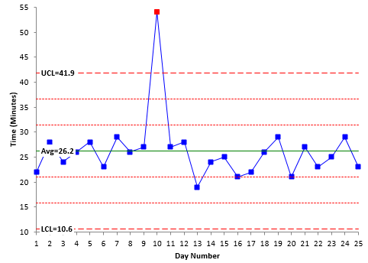
What is Statistical Process Control?
One of the Key Control Activities is monitoring process performance using Statistical Process Control (SPC).
SPC uses control charts to:
Monitor process performance over time.
Identify process variation.
Determine whether a process is operating consistently.
Provide early warning signs when action is needed.
Outside control limits
Within control limits
Within control limits
Control charts help identify when a process is moving out of control and requires investigation.
Notes:
Statistical Process Control uses control charts to show how a process performs over time. It helps us see variation, judge whether the process is behaving consistently, and recognize early warning signals.
Look at the chart. Most points sit between the upper and lower control limits. That suggests the process is operating within its expected pattern. One point is above the upper limit. That point does not tell us the cause, and it does not automatically prove the whole process has failed. It tells us that something unusual may have happened and that we should investigate.
Imagine this chart represents days from eligibility approval to service enrollment. A point outside the limit might be connected to a system outage, delayed documentation, an unusually complex case, or a staffing disruption. We use evidence to find out which explanation, if any, is correct.
Key message: SPC tells us where to ask questions. It does not replace investigation.
Transition: Let’s apply that idea to a simple example.

Slide 8
Real-World Example
Scenario
A team tracks how long it takes to complete a routine process each day.
Average time = 26 minutes
Most results are within the control limits
One result reaches 54 minutes
What should the team do?
A. Change the process immediately.
B. Investigate why Day 10 was different.
Notes:
In this scenario, a team tracks the time required to complete a routine process. The average is 26 minutes, and most results fall within the expected limits. On Day 10, the result reaches 54 minutes.
What should the team do: change the process immediately, or investigate why Day 10 was different? The best answer is to investigate.
For an Equus example, suppose participant intake normally takes around 30 minutes, but one day the average rises sharply. Before redesigning the intake process, we would check what changed. Was the case management system slow? Were more participants completing complex program eligibility steps? Was required documentation unavailable? Did a new compliance requirement take effect?
SPC prevents us from reacting to one result without understanding the context. It directs our attention to a signal and helps us ask better questions.
Transition: To interpret that signal correctly, we need to understand process variation.

Slide 9
02
Process Variation
CONTROL LSS27
Notes:
This section focuses on process variation.
Every process varies. Two participants can follow the same service pathway and still take different amounts of time to complete eligibility, assessment, or enrollment. That does not automatically mean someone made a mistake.
Our goal is not to eliminate every difference. Our goal is to separate normal variation from variation that suggests the process has changed.
Transition: A bowling analogy makes this easier to visualize.

Slide 10



An analogy…
Even when the same process is followed, different outcomes can occur.
Example:
A person bowls the ball using the same approach each time.
Why does he get different results?
Different levels of natural variation.
Unplanned events affecting the outcome.
Small differences in how the process is performed.
Strike!
Outcome meets the expectations.
Miss!
Falls short of expectations.
SPC helps distinguish between normal variation and variation that signals a problem.
Notes:
Think of a bowling lane as a process. The ball is the work moving through the process, and the pins represent the outcome we want.
A bowler can use the same general approach several times and still get different results. Small changes in speed, release, direction, or conditions affect where the ball goes. Some variation is naturally present, even when the process is followed consistently.
The same is true at Equus. A Career Coach may complete the same review process with two participants, but one conversation takes longer because the participant has additional questions or needs more documentation. That difference may be normal. A very different result, such as a long delay caused by a system outage, may signal something unusual.
SPC helps us tell the difference.
Transition: In Lean Six Sigma, we describe those two kinds of variation as common cause and special cause.

Slide 11
Process Variation
Every process contains variation. SPC helps us determine whether that variation is normal or whether something unusual has occurred.
Process Variation
Common Cause
Special Cause
Natural variation that is built into the process.
Features:
Expected
Predictable
Always present
Multiple causes
Example: Calls normally take 4–6 minutes. Small differences in call length are expected.
Unusual variation caused by a specific event or issue.
Features:
Unexpected
Unpredictable
Usually one cause
Requires investigation
Example: A phone outage increases call times from 4–6 minutes to 20 minutes and requires investigation.
Notes:
Common cause variation is the natural variation built into a process. It is expected, generally predictable, and created by many small influences.
For example, if participant reviews usually take between four and six days, results within that range may reflect normal differences in case complexity, scheduling, documentation, or workload.
Special cause variation comes from a specific event or change that is not part of the usual process. If the case management system becomes unavailable and review time increases to 20 days, that is a signal requiring investigation.
One of the biggest mistakes teams make is treating every fluctuation as a special cause. That leads to unnecessary firefighting and can put pressure on employees for variation that actually comes from the system. The opposite mistake is ignoring a genuine signal.
Key message: common cause is the routine pattern of the process. Special cause tells us something unusual may have changed.
Transition: The response should be different depending on the type of variation.

Slide 12
Managing Variation
According to Deming:
94%
6%
Common Cause
Can only be eliminated or improved by management and improvement activities.
Built into the process:
Improve the process.
Standardize work.
Remove waste and inefficiencies.
Usually requires management action.
Special Cause
The cause should be confirmed with the employee completing the work. Management should work with process users to improve standardization and remove the variation.
Caused by a specific event:
Investigate what happened.
Speak to the people doing the work.
Identify the root cause.
Remove the cause or embed the improvement.
Notes:
W. Edwards Deming emphasized that most variation comes from the system rather than from individual employees. The percentages on the slide illustrate that most performance variation should be addressed through management and process improvement, while a smaller portion comes from specific events.
For common cause variation, improve the process. That might mean simplifying participant intake, clarifying standard work, balancing caseloads, improving data quality, or removing repeated handoffs.
For special cause variation, investigate the event. Speak with the employees closest to the work, review the facts, identify what changed, and determine the appropriate response.
For example, if referral-to-enrollment time is consistently too long but stable, the process itself needs improvement. If results are normally stable and then rise sharply during a state system outage, investigate and address that specific disruption.
Remember the simple distinction: common cause means improve the process. Special cause means investigate the cause.
Transition: Let’s test that distinction with several workforce services scenarios.

Slide 13
Activity: Common or Special Cause
A Career Coach normally completes 6–8 participant reviews per day. One day only 2 reviews are completed because the case management system is unavailable.
Activity Instructions
Read each scenario and decide whether it is:
Common Cause Variation (normal variation built into the process).
Special Cause Variation (unusual variation requiring investigation).
A housing assessment normally takes 3–5 working days to complete. One application is completed in 4 days.
A Childcare Advisor normally has between 8-12 eligibility verifications per day. Today they only processed 4.
An occupational health referral normally takes 10–12 days from referral to assessment. One referral takes 25 days due to staff absence.
A payroll system error causes 500 employees to receive incorrect pay checks.
Notes:
For this activity, read each scenario and decide whether it represents common cause variation or special cause variation.
Common cause means the result fits the normal pattern of the process. Special cause means something unusual has occurred and the result deserves investigation.
For each example, do not focus only on whether the result is good or bad. Ask two questions: Is the result within the expected pattern, and is there evidence of a specific event?
Pause after each scenario and invite responses in the chat. Ask participants to include a short reason, not just the classification.
Facilitator prompts: What evidence supports your answer? What additional information would you want before taking action? Would this require process improvement or investigation?
Transition: Let’s compare our reasoning with the answers.

Slide 14
Activity: Answers
Scenario | Common Cause or Special Cause? | Why?
A Career Coach normally completes 6–8 participant reviews per day. One day only 2 reviews are completed because the case management system is unavailable. | Special Cause | A system outage is an unusual event that is not part of normal process performance.
A housing assessment normally takes 3–5 working days to complete. One application is completed in 4 days. | Common Cause | The result falls within the expected process range.
A Childcare Advisor normally completes 8–12 eligibility verifications per day. Today they complete 10. | Common Cause | The result is within the normal expected range for the process.
A childcare advisor normally completes 8–12 eligibility verifications per day. Today they only complete 4. | Special Cause | Performance is significantly outside the expected range and suggests something unusual has occurred.
An occupational health referral normally takes 10–12 days from referral to assessment. One referral takes 25 days due to staff absence. | Special Cause | Staff absence is a specific event that has created unusual variation.
A payroll system error causes 500 employees to receive incorrect paychecks. | Special Cause | A system error is not part of normal process behavior and requires immediate investigation.
Notes:
Let’s review the answers.
The Career Coach scenario is special cause because the case management system outage is a specific unusual event. The housing assessment completed in four days is common cause because it falls inside the normal three-to-five-day range.
The Childcare Advisor completing ten verifications is common cause because ten fits the normal range of eight to twelve. Completing only four may be a special cause signal, but in practice we would still investigate before deciding why it occurred.
The occupational health referral taking 25 days due to staff absence is treated here as special cause because a specific disruption is identified. The payroll system error is also special cause and needs immediate investigation.
The key is not to label a person as the cause. We classify the pattern, gather evidence, and respond to the process or event appropriately.
Transition: Now that we can distinguish the two types of variation, let’s look more closely at the control chart itself.

Slide 15
03
Using Control Charts
CONTROL LSS27
Notes:
We are beginning the next section: using control charts.
We have established that every process contains variation. Now we will look at the chart features that help us decide whether that variation appears normal or unusual.
As we continue, keep an Equus measure in mind, such as days from referral to enrollment, assessment completion time, customer wait time, or incomplete case records. Consider how a control chart could help a Process Owner monitor that measure over time.
Transition: Let’s define the basic parts of a control chart.

Slide 16



What is a Control Chart?
A Control Chart is a graphical tool used to monitor process performance over time and distinguish between normal variation and unusual variation.
Key Components:
Why Use a Control Chart?
Monitor process stability.
Identify unusual changes or trends.
Detect issues before performance is impacted.
Verify whether improvements are sustained.
Data Points
Measurements collected over time.
Centre Line (CL) The process average.
Control Limits Upper and lower boundaries of expected variation.
Notes:
A control chart is a graph of process results in time order. It contains three main elements.
The data points are the measurements collected over time. The center line represents the process average. The upper and lower control limits represent the expected boundaries of normal process variation.
Control charts help us monitor stability, identify unusual changes or patterns, detect signals early, and check whether an improvement is sustained.
For example, after an Equus team improves orientation scheduling, a chart of days from enrollment to orientation can show whether the new performance remains stable. We should not react to every small increase or decrease. We look for meaningful signals.
Key message: the chart helps separate signal from noise.
Transition: Let’s label the three reference lines and see how they guide interpretation.

Slide 17
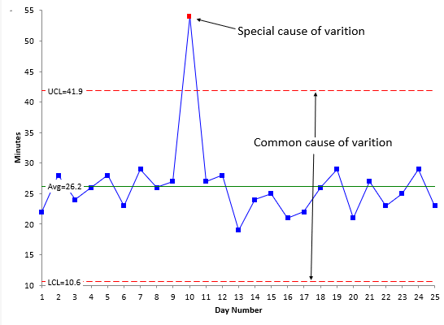
Features of a Control Chart
SPC uses control charts to identify process variation and detect when a process may be moving out of control. Control charts contain three key reference lines:
UCL – Upper Control Limit. The highest value expected from normal process variation.
UCL is calculated using standard deviation: Mean + 3σ.
Key Features of a Control Chart
Control limits define the expected range of variation.
Most data points should fall within the control limits.
Points outside the limits indicate potential special cause variation.
CL Centerline. The process average.
LCL – Lower Control Limit. The lowest value expected from normal process variation.
LCL is also calculated using standard deviation: Mean - 3σ
Control limits help us distinguish between common cause and special cause variation.
Notes:
Every control chart includes an upper control limit, a center line, and a lower control limit.
The center line is the process average. The upper and lower limits show the range we would expect from normal process variation. On this slide, the limits are described as three standard deviations above and below the mean.
Most results in a stable process should fall inside the limits. A point outside a limit is a potential special cause signal and should be investigated.
It is important not to confuse control limits with customer requirements or contractual targets. Control limits describe what the process is currently capable of producing. A process can be statistically stable and still perform below the level customers or funders require.
For an Equus project, enrollment time might remain stable between seven and ten days even when the contract target is five days. That stable pattern still requires process improvement.
Transition: So why are these charts worth using in day-to-day management?

Slide 18
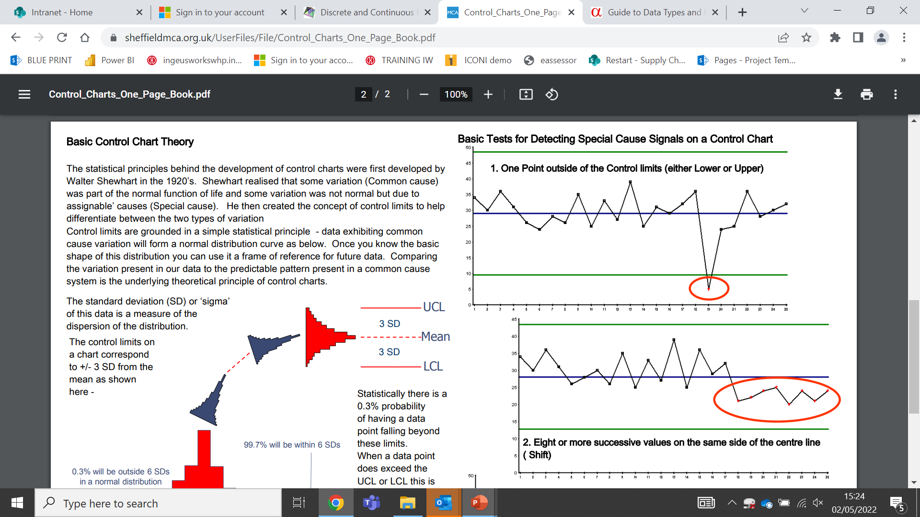
Why Are Control Charts Important?
Separate Signal from Noise
Control charts help distinguish between common cause variation and special cause variation.
Monitor Improvement Over Time
Control charts help determine whether a change has genuinely improved the process.
Support Better Decisions
They reduce the risk of reacting to normal fluctuations in performance.
Identify Real Process Changes
Control charts highlight when something unusual has happened and investigation is needed.
Reduce Firefighting
Teams can focus on genuine issues instead of chasing every out-of-control result.
Notes:
Control charts are important because they help us separate real signals from routine fluctuation.
That supports better decisions. Instead of changing staffing, coaching an employee, or redesigning a workflow because of one ordinary result, leaders can focus on evidence that the process has actually changed.
They also help us verify improvement. If a new participant reminder process appears to reduce missed appointments, the control chart helps us judge whether performance shifted and stayed at the new level, rather than improving briefly by chance.
This reduces firefighting. Teams spend less time chasing every high or low point and more time investigating genuine signals or improving a consistently underperforming process.
Transition: Another way to describe this is listening to the voice of the process.

Slide 19
Control Charts: The Voice of the Process
Control charts help us hear the Voice of the Process by showing how a process is performing over time.
They help us distinguish between normal process variation and signals that may require investigation or improvement.
Notes:
A control chart is often described as showing the Voice of the Process. In plain language, it shows what the process is actually producing over time.
That voice may agree with our expectations, or it may challenge them. A team may feel that participant intake is unpredictable, while the data shows a stable pattern. Another team may feel that a new workflow is working well, while the chart shows repeated unusual signals.
Before making changes, we listen to the data and then combine it with operational knowledge from the people doing the work.
For Equus teams, this means pairing the chart with frontline context. The data identifies the signal. Career Coaches, Workforce Specialists, Program Managers, and support teams help explain what changed.
Transition: Let’s return to the bowling analogy and connect it to the chart lines.

Slide 20

Back to our analogy…
Special Cause Variation
Special Cause Variation
CL
Center Line/
Process Average
UCL
Upper Control Limit
LCL
Lower Control Limit
Notes:
Imagine the center of the bowling lane as the process average and the gutters as the control limits.
The ball does not travel down the exact center every time. Small movements from side to side are normal, just as service times or daily workload naturally rise and fall.
If the ball stays within the lane, the process is behaving within its expected pattern. If the ball enters the gutter, it signals that something unusual happened, such as a slip, a poor release, or a distraction.
We would not rebuild the bowling lane after one ordinary throw. In the same way, we should not redesign an Equus process because of one result that sits within normal variation. When a genuine special cause signal appears, we investigate what was different.
Key takeaway: common cause variation calls for improvement to the system. Special cause variation calls for investigation of a specific change.
Transition: A point beyond a limit is one special cause rule, but it is not the only pattern to watch for.

Slide 21
Special Cause Rules
Special causes of variation are detected on control charts through patterns that suggest the process is behaving differently from normal.
A point that falls beyond the Upper Control Limit (UCL) or Lower Control Limit (LCL) is a strong indication of special cause variation.
Other indicators may include a run of consecutive points on the same side of the center line, a trend, or another unusual pattern.
These signals suggest that something unusual has occurred within the process and should be investigated.
Understanding special causes helps us decide whether corrective action is needed or whether a positive improvement should be sustained.
Just as a bowling ball entering the gutter signals something unusual has happened, special cause rules help us identify unusual variation within a process.
Notes:
Special cause rules help us recognize patterns that are unlikely to be part of normal process behavior.
The clearest signal is a point beyond the upper or lower control limit. We can also look for patterns such as several consecutive points on the same side of the center line or a sustained upward or downward trend.
A single point might reflect a one-time disruption. A run of points on one side of the center line may suggest the whole process has shifted to a new level.
For example, if participant assessment time remains below the center line for several consecutive periods after a simplified form is introduced, the improvement may have shifted the process. If the same pattern appears after a policy change added steps, the process may have shifted in the wrong direction.
Transition: Here is another everyday example of common and special cause variation.

Slide 22
Common & Special Variation
Scenario
This chart represents average daily commute times over 25 working days.
Most data points fall between 20 and 30 minutes, showing the normal ups and downs we expect from traffic conditions. These points represent common cause variation.
A single point at approximately 54 minutes stands out because it falls above the Upper Control Limit.
This suggests a special cause occurred, such as a traffic accident, road closure, or severe weather event.
Special Cause variation
Common Cause variation
Notes:
Think about a daily commute. Most days the journey varies within a familiar range because of normal traffic volume, traffic lights, weather, and road activity. Those small differences are common cause variation.
One day, the commute takes 54 minutes because a major accident closes part of the route. That result sits outside the expected range and suggests a special cause.
The same reasoning applies to workforce operations. Daily enrollment volumes may move up and down within a normal range. A sudden, extreme drop connected to a case management outage would be a special cause signal.
Notice that we still investigate. The chart does not know there was an accident or an outage. It only shows that the result was unusual. Operational evidence explains the cause.
Transition: For this module, we will focus on two common rules for detecting those signals.

Slide 23
Special Cause Rules
There are several rules used to identify special cause variation on a control chart.
The examples shown illustrate two of the most common special cause rules and help us identify when a process may have changed.
A control chart like this could be used represent either of the following:
Average time to complete an eligibility assessment.
Average number of days to process a customer application.
Average time from referral to service enrolment.
Average time to complete a customer orientation session.
Rule 1
Rule 2
Notes:
There are several formal rules for identifying special cause variation. Today we will focus on two that are easy to recognize and useful in practice.
Rule 1 is one point outside the control limits. That is a strong signal that the result is not consistent with the current process pattern.
Rule 2 is eight consecutive points on the same side of the center line. Even though every point may still be inside the limits, the run suggests the process average may have shifted.
The chart could represent days to complete eligibility, time from referral to enrollment, orientation completion time, or another process measure collected consistently over time.
For either rule, the response is not to guess. We identify the time period, review what changed, speak with the people closest to the work, and gather evidence.
Transition: Let’s start with the one-point signal and consider possible causes.

Slide 24
1-point Special Cause Variation - Cause
In SPC, our job is to identify what made this point different from the others.
Potential Causes
New team member completing the work.
System outage or application issue.
Incorrect data entered.
Required process step missed.
Unusually complex customer case.
Staffing shortage or unexpected absence.
Change in policy or business rules.
Equipment or technology failure.
Special cause signals tell us that something has changed.
Notes:
This chart contains one point beyond a control limit. Our job is to ask, what was different at that point in time?
Possible explanations include a system issue, incorrect data, a missed step, an unusually complex case, unexpected staff absence, a policy change, or a technology failure. These are hypotheses, not conclusions.
In an Equus project, a sharp increase in referral-to-enrollment time might be connected to delayed eligibility documents, a state system outage, an unusual surge in referrals, or a local staffing disruption. A sharp improvement might follow a successful scheduling change or automation.
A special cause is not automatically negative. It simply means the result differs from the established pattern. If the cause improved performance, we may want to standardize it. If it harmed performance, we may want to remove or prevent it.
Key question: What evidence shows what was different about this point?
Transition: A repeated run tells a different story from a single unusual point.

Slide 25
8-Point Special Cause Variation - Causes
In SPC, our job is to identify what has caused the process to shift from its normal pattern.
Potential Causes
A new process or way of working has been introduced.
A policy or business rule has changed.
Staff have received new training or coaching.
A different team is completing the work.
A new system or technology has been implemented.
Work has been reassigned between teams.
Automation has been introduced.
Customer demand or case complexity has changed.
Special cause signals such as eight consecutive points on the same side of the center line suggest the process has shifted to a new level of performance.
Notes:
Here we have eight consecutive points on the same side of the center line. That pattern suggests the process may have shifted to a new level of performance.
Unlike a single event, a shift is often connected to a sustained change: a new workflow, policy, training approach, team assignment, system, automation, or change in customer demand.
Imagine the chart represents average days to complete participant enrollment. Eight points below the center line after a documentation checklist was introduced may indicate a lasting improvement. Eight points above the center line after new approval steps were added may indicate a lasting delay.
The direction alone does not tell us whether the change is good. For some measures, lower is better; for others, higher is better. We need to understand the measure and the customer requirement.
Our job is to identify what changed, confirm the relationship with evidence, and decide whether to sustain, improve, or correct the new process.
Transition: Once we identify a special cause signal, here is the response process.

Slide 26
Special Cause Variation - Actions
When a special cause signal is identified, follow these steps:
Investigate
Understand what changed in the process.
Talk to Employees
Speak with the people closest to the work.
Gather Evidence
Use facts and data, not assumptions.
Remove Negative Causes
Address issues impacting performance.
Standardize Positive Causes
Embed and sustain improvements into the process.
Special cause signals are opportunities to learn. Investigate the change, understand the cause, and take appropriate action.
Notes:
When a special cause signal appears, start by investigating what changed.
Speak with the employees closest to the work. They often know about system problems, changes in demand, new requirements, workarounds, or improvements that are not obvious in a report.
Then gather evidence. Review dates, process records, system notices, staffing context, and data quality. Do not assume the first explanation is correct.
If the cause harmed performance, remove it, reduce its effect, or prevent it from recurring. If the cause improved performance, document it, standardize it, and consider applying it more broadly.
For example, if appointment completion improves after a text reminder pilot, confirm the timing and results before embedding the practice. If completion drops during a system disruption, address the disruption and update contingency procedures.
Key message: do not simply react to the signal. Learn from it and take evidence-based action.
Transition: The goal of all this work is a stable and predictable process.

Slide 27
The Goal: A Stable and Predictable Process
Create Process Stability
Achieve a predictable and controlled process.
Investigate Signals
Identify and understand process changes.
Understand Variation
Distinguish between common and special causes.
Statistical Process Control helps us understand variation, identify meaningful process changes, and create stable, predictable performance.
Notes:
The purpose of SPC is not to create a perfect process with no variation. Some variation will always exist.
The goal is to understand the variation, identify meaningful changes, and create performance that is stable and predictable.
A stable Equus process allows teams to plan resources, set realistic expectations for participants and partners, and recognize problems earlier. For example, if referral-to-first-contact time is stable, the Process Owner can predict service capacity. If the pattern shifts, the chart provides an early signal.
When we see common cause variation, we improve the system. When we see special cause variation, we investigate what changed. Over time, that disciplined response reduces firefighting and supports more reliable customer experiences.
Transition: Now let’s look at the different chart types available and how the data determines which one to use.

Slide 28
04
Types of Control Charts
CONTROL LSS27
Notes:
We are beginning the section on types of control charts.
Different charts are designed for different types of data and collection methods. Choosing the wrong chart can produce misleading limits and lead to the wrong conclusion.
We will focus on the chart types most relevant to the examples in this module, particularly individual measurements and small groups of continuous measurements.
Transition: The first decision is whether the data is measured on a scale or counted as whole events.

Slide 29
Control Chart Selection
Control charts are the most common tools for SPC and tracking variation. The type of chart you choose depends on the data being collected (e.g., discrete or continuous data).
Chart Type | Type of Data | When to Use It | Example
I-MR Chart | Continuous | Individual measurements collected over time. | Average call handling time.
Xbar-R Chart | Continuous | Measurements collected in small groups. | Assessment completion time across teams.
c-Chart | Discrete | Count of events or defects. | Number of customer complaints received.
🟦 Continuous Data
Measured on a scale
Examples: minutes, hours, dollars, days
🟩 Discrete (Attribute) Data
Counted as whole numbers
Examples: complaints, errors, defects, missed appointments
Notes:
Control chart selection starts with the type of data.
Continuous data is measured on a scale and can include values such as minutes, hours, days, dollars, or distance. Equus examples include days from referral to enrollment, minutes spent waiting for service, or time to complete an eligibility assessment.
Discrete data is counted in whole numbers. Examples include customer complaints, data-entry errors, missed appointments, or incomplete records.
An I-MR chart is used for individual continuous measurements collected one at a time. An X-bar and R chart is used when continuous measurements are collected in consistent small groups. A c-chart is used for counts of events or defects under appropriate, consistent conditions.
Chart selection matters because the control limits are calculated differently. We need a clear measure, consistent definitions, and reliable data before interpreting the result.
Transition: Let’s start with the I-MR chart.

Slide 30
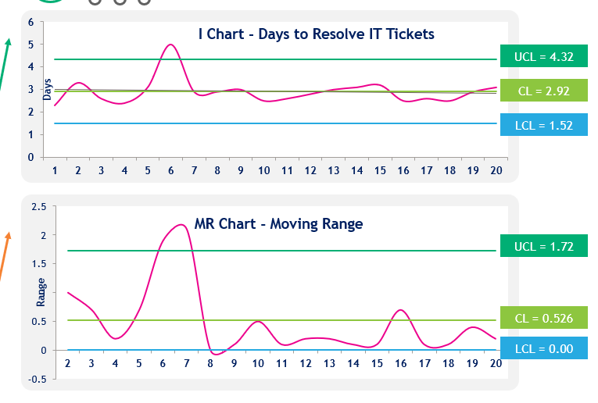
What is an I-MR Chart?
An I-MR Chart is used to monitor process performance when data is collected one observation at a time.
It consists of two charts:
Individuals (I) Chart - Shows the actual values collected over time.
Moving Range (MR) Chart - Shows how much the process changes between consecutive observations.
Example Usage:
Average assessment completion time
Average call handling time
Invoice processing time
Time to resolve an IT ticket
Notes:
I-MR stands for Individuals and Moving Range. This chart is useful when observations are collected one at a time.
The Individuals chart shows each actual result over time. For example, each point could represent the number of days required to complete one participant assessment or resolve one support ticket.
The Moving Range chart shows the absolute difference between one observation and the next. If Day 1 is five days and Day 2 is seven days, the moving range for Day 2 is two days.
The two charts answer different questions. The Individuals chart shows whether the actual results are stable. The Moving Range chart shows whether the amount of change between consecutive results is stable.
There is no moving range for the first observation because there is no earlier result to compare with it.
Transition: The next slide walks through both charts using ticket resolution time.

Slide 31
Example – IT Ticket Resolution Times
I Chart (Average Resolved IT Tickets)
Most tickets are resolved in about 3 days.
One ticket took approximately 5 days.
This exceeds the UCL of 4.32 days.
This is a special cause signal.
Possible causes:
System outage
Complex technical issue
Vendor dependency
Staff availability issue
UCL = 4.32
CL = 2.92
LCL = 1.52
MR Chart (Average Resolved IT Tickets)
This chart shows how much each ticket differs from the previous ticket.
Most ticket-to-ticket changes are small.
The jump between Tickets 5 and 6 is unusually large.
The moving range exceeds the UCL.
This confirms something unusual happened
UCL = 1.72
CL = 0.526
LCL = 0.00
Tickets sampled
Notes:
The top chart shows the individual ticket resolution times. Most tickets are resolved in about three days, close to the center line of 2.92 days. Ticket 6 takes approximately five days, which is above the upper control limit of 4.32. That is a special cause signal.
The bottom chart shows the moving range between consecutive tickets. The change into Ticket 6 and the change out of Ticket 6 are unusually large and exceed the moving-range limit. Both charts tell us that something different happened around that observation.
We would investigate possibilities such as a complex technical issue, vendor dependency, system outage, staffing availability, or a data-entry error. We would not select a cause without evidence.
To calculate a moving range, subtract consecutive values and use the absolute difference. Ticket 2 is 3.3 days and Ticket 1 is 2.3 days, so the range is 1.0 day. Ticket 3 is 2.6 days, so the absolute difference from Ticket 2 is 0.7 day.
Equus connection: the same chart could monitor individual eligibility completion times or days from referral to first service.
Transition: When data is collected in consistent groups, we use a different pair of charts.

Slide 32
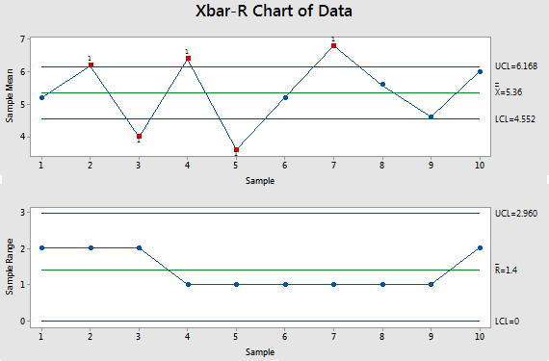

Using X-Bar and R Charts to Monitor Process Performance
Days to complete onboarding
X Bar Chart
Monitors the average number of days taken to complete onboarding for each sample of new employees.
Use the X Bar Chart to identify:
Changes in average onboarding time
Trends and patterns over time
Special cause variation that may require investigation
Example: Average onboarding completion time for a sample of 5 employees.
X Bar Chart
Range Sample – days to complete
R Chart
Monitors the variation in onboarding times within each sample group.
The R Chart shows the difference between the shortest and longest onboarding times within the sample.
This helps identify whether onboarding times are becoming more or less consistent.
Example: Difference between the shortest and longest onboarding times within a sample of 5 employees.
R Chart
Understanding the range helps identify whether process performance is becoming more consistent or more variable over time. A process can maintain the same average while variation increases or decreases.
Notes:
The X-bar and R charts work together when we collect continuous data in small, consistent groups.
The X-bar chart monitors the average result for each sample. In this example, each sample contains five employees, and the measure is average onboarding time. The chart answers: Has the average process performance changed?
The R chart monitors the range within each sample, which is the difference between the shortest and longest result. It answers: Has the consistency of the process changed?
We need both charts because an average can remain stable while variation grows. For an Equus example, two offices might have the same average enrollment time, but one office may have much less consistent participant experiences.
Always interpret the R chart and the X-bar chart together. Stable averages do not guarantee stable variation.
Transition: Let’s calculate the average and range for one sample.

Slide 33
Example: X Bar and R Chart
Observation 1 Example
Days to complete Onboarding
X bar shows 5.2.
Sample:
4+5+5+6+6 = 26
26/5 = 5.2
X Bar Chart
Employee | Days to Onboard
A | 4
B | 5
C | 5
D | 6
E | 6
Range Sample – days to complete
R Chart
R bar shows.
Sample:
Highest (6) – lowest (4) = 2
Observations
For each, the sample size must be the same.
Notes:
This example uses a sample of five employees with onboarding times of four, five, five, six, and six days.
To calculate the sample average, add the values to get 26 and divide by five. The X-bar value is 5.2 days.
To calculate the range, subtract the lowest value from the highest value. Six minus four gives a range of two days.
The same calculation is completed for each sample group and plotted over time. Every subgroup should use the same sample size and a consistent collection method so the results are comparable.
For an Equus application, a sample might include five participant enrollments completed each week. The X-bar chart would monitor average completion time, while the R chart would show the spread between the shortest and longest completion times in each sample.
One correction to note while presenting: the lowest value in this example is four, not two. The range is still two because six minus four equals two.
Transition: Now let’s interpret what the pair of charts tells us about a full process.

Slide 34
Analyze the Process
There are 6 steps in the process:
New hire details
Background checks
IT
onboarding
IT Equipment
Orientation
Onboard complete
X-Bar Chart (Average Days to Complete Onboarding)
The average onboarding time is not stable.
The overall average is 5.36 days.
Samples 2, 4, and 7 are above the Upper Control Limit.
Samples 3 and 5 are below the Lower Control Limit.
This suggests that something unusual is affecting the average onboarding time during those samples.
R Chart (Variation Within Each Sample)
The variation between employees appears to be stable.
The average range is 1.4 days.
All points fall within the control limits.
There are no special cause signals.
This suggests that the difference between the quickest and longest onboarding times remains relatively consistent.
Possible Causes of Variation
Potential:
Delays in equipment delivery
Delayed manager approvals
Access provisioning issues
Incomplete documentation
Differences in onboarding complexity
SPC charts help us monitor onboarding completion times and identify unusual variation that may require investigation.
Notes:
This example applies X-bar and R charts to employee onboarding across six process steps, from collecting new-hire details through completion.
The X-bar chart shows that the average onboarding time is not stable. The overall average is 5.36 days, and several samples fall beyond the control limits. That means we should investigate what changed during those sample periods.
Possible areas to examine include equipment delivery, manager approvals, access provisioning, incomplete documentation, and differences in onboarding complexity. These are starting points for investigation, not confirmed causes.
The R chart tells a different story. The average range is 1.4 days, all points remain inside the limits, and no special cause pattern is identified. The spread within each group appears stable even though the group averages are shifting.
For Equus, the same approach could examine referral-to-enrollment time across weekly samples. It would help separate a change in the average experience from a change in consistency across participants.
Transition: After an improved process becomes stable, we establish the new baseline and prepare for closure.

Slide 35
05
Re-baseline and closure
CONTROL LSS27
Notes:
We are entering the final section: re-baselining and project closure.
Once an improvement has been implemented and shown to be stable, the team needs to define the new expected level of performance. That new baseline becomes the reference point for future monitoring.
Closure also means transferring ownership. The project team should leave the Process Owner with clear measures, definitions, responsibilities, review routines, and response steps.
Transition: Let’s review the actions required before the process becomes business as usual.

Slide 36
Re-baseline and Closure
Before releasing the improved process into Business as Usual (BAU), complete the following:
Confirm the new baseline and validate key performance measures.
Communicate the improvement and its impact.
Recognise contributors and stakeholders who supported the change.
Secure ongoing support for sustaining the improvement.
Handover the process and performance measures to the Process Owner.
Complete the project closure report, including benefits achieved and new metrics.
The new baseline becomes the benchmark for future performance and improvement.
Baseline
Implement & Validate
Re-baseline
Notes:
Before releasing the improved process into business as usual, confirm the new baseline and validate the key measures.
Communicate what changed, why it matters, and what results were achieved. Recognize the contributors who helped design, test, and implement the improvement. Their knowledge and support are important for sustaining it.
Formally hand over the process to the Process Owner. The handoff should include the control plan, measure definitions, data source, review frequency, expected limits or thresholds, and the action to take when a signal appears.
For an Equus project that improved participant onboarding, the closure report might document the new average completion time, the monitoring dashboard, ownership of the measure, and escalation steps for unusual variation.
The new baseline is not the end of improvement. It becomes the benchmark for future performance and the starting point for the next improvement opportunity.
Transition: Let’s close by bringing the major ideas together.

Slide 37
Summary
The Control phase sustains improvements.
SPC uses control charts to monitor process performance.
Control charts provide early warning signals when processes change.
SPC uses:
Discrete data (counted)
Continuous data (measured)
Understand the difference between:
  Common Cause Variation (normal)
  Special Cause Variation (requires investigation)
Notes:
Let’s summarize the key points from the module.
The Control phase is designed to sustain improvements. Statistical Process Control uses data in time order to monitor process performance and provide early warning signals when the pattern changes.
Control charts can be built from continuous data, such as minutes or days, and discrete data, such as counts of complaints or errors. The data type and collection method determine the appropriate chart.
Common cause variation is the normal variation built into the process. When the stable process is not meeting the need, improve the process. Special cause variation suggests something unusual has changed. Investigate the cause before acting.
For Equus teams, these concepts support more consistent participant experiences, better operational decisions, and more reliable performance monitoring.
Quick check: What is one measure in your area that would benefit from being viewed over time rather than as a single monthly result?
Transition: The next slide contains optional resources for continued learning.

Slide 38
Additional Resources
Standard Deviation: https://www.mathsisfun.com/data/standard-deviation-formulas.html
Creating a basic control chart: https://youtu.be/os17KYZAnd0?si=4dbZqunnxfwM9BgB
Control chart basics: https://youtu.be/Aj7lJLR-7b4?si=FNq6yV6vMml70oLZ
Creating I-MR charts: https://youtu.be/uGgd3iiQrUI?si=3vBFuoFLaePtKNL6
Notes:
These resources provide additional support if you want to explore the calculations or practice creating control charts.
The first resource reviews standard deviation. The remaining resources introduce basic control chart concepts and I-MR chart creation.
As you use external examples, bring the thinking back to a real process. Start with a clear operational definition, confirm the data is reliable and ordered over time, choose the chart that matches the data, and then interpret signals with the people closest to the work.
For an Equus application, a good practice exercise would be to chart referral-to-first-contact time, assessment completion time, missed appointments, or case-record errors using a consistent definition and collection period.
Transition: Let’s close the session.

Slide 39
Thank you
Thank you for your participation. You have now completed the learning for this module.
Once your attendance has been captured, your module end test will be available. Slides for this session will also be available for review.
Notes:
Thank you for your participation today.
You have now completed the Statistical Process Control learning module. We covered how to distinguish common cause from special cause variation, how to read the main features of a control chart, how I-MR and X-bar and R charts are used, and how SPC supports re-baselining and sustained improvement.
The most important takeaway is to avoid reacting to every individual result. Listen to the process, investigate genuine signals, and improve the system when routine performance is not meeting the need.
Once attendance has been recorded, the module-end test will become available, and the slides will be available for review.
Before we finish, I’m happy to address any final questions in the chat.

